Slide 1
"Those who were seen dancing were
thought to be insane by those who could not
hear the music" - Fyodor Dostoevsky

Slide 2
Greetings!
Armaan, 15 this year
I love M.U.Ns, Coding, Pòkemon, and chess!
Jack of all trades but the master of none, yet
Attended over 20+ hackathons and won 10+, ig?
I suck at ui/ux
a noob trying to get better :)

Slide 3
AN IMPORTANT NOTE

Slide 4
WHY SHOULD YOU EVEN CODE AT THE FIRST PLACE?

Slide 5
The mediocre mentor tells, a good mentor explains, the super mentor demonstrates, the greatest mentors inspires - Lucia Ballas Traynor

Slide 6
Before we start, I'm using:
Linux Ubuntu v24, Hyprland for ubuntu
We will be using: zapp.run

Slide 7
Personal links:
armaan33000@gmail.com
https://GitHub.com/0Armaan025
https://devpost.com/armaan33000
https://x.com/0armaan025
Resource link: https://github.com/0Armaan025/img-editor-web

Slide 8
Test your skills:
https://devpost.com/
https://leetcode.com/
https://www.geeksforgeeks.org/
https://devfolio.co/
https://www.hackthebox.com/
https://tryhackme.com/

Slide 9
Super cool roadmap site:
https://roadmap.sh

Slide 10
the tech stack I use vs I wanna use:
Flutter/Dart + NodeJS(express stuff)
MongoDB + Firebase
Flutter/Dart + NodeJS(express stuff) + BLoC + riverpod + rive + MongoDB + Firebase
NextJS + Tailwind CSS + NodeJS(express stuff again) + Framer + Shadcn + Firebase + MongoDB
NextJS + Tailwind CSS + NodeJS(express stuff again) + Framer + Shadcn + Firebase + MongoDB + zustand + redux + graphql + drizzle
For general stuff, Python ftw, and usually cpp with sdl2 these days (I'm relearning for something that I wish to conceal)
For general stuff, I wanna use rust, fastapi (python), opengl+cpp+sdl3

Slide 11
IT'S NEVER TOO LATE - anon

Slide 12





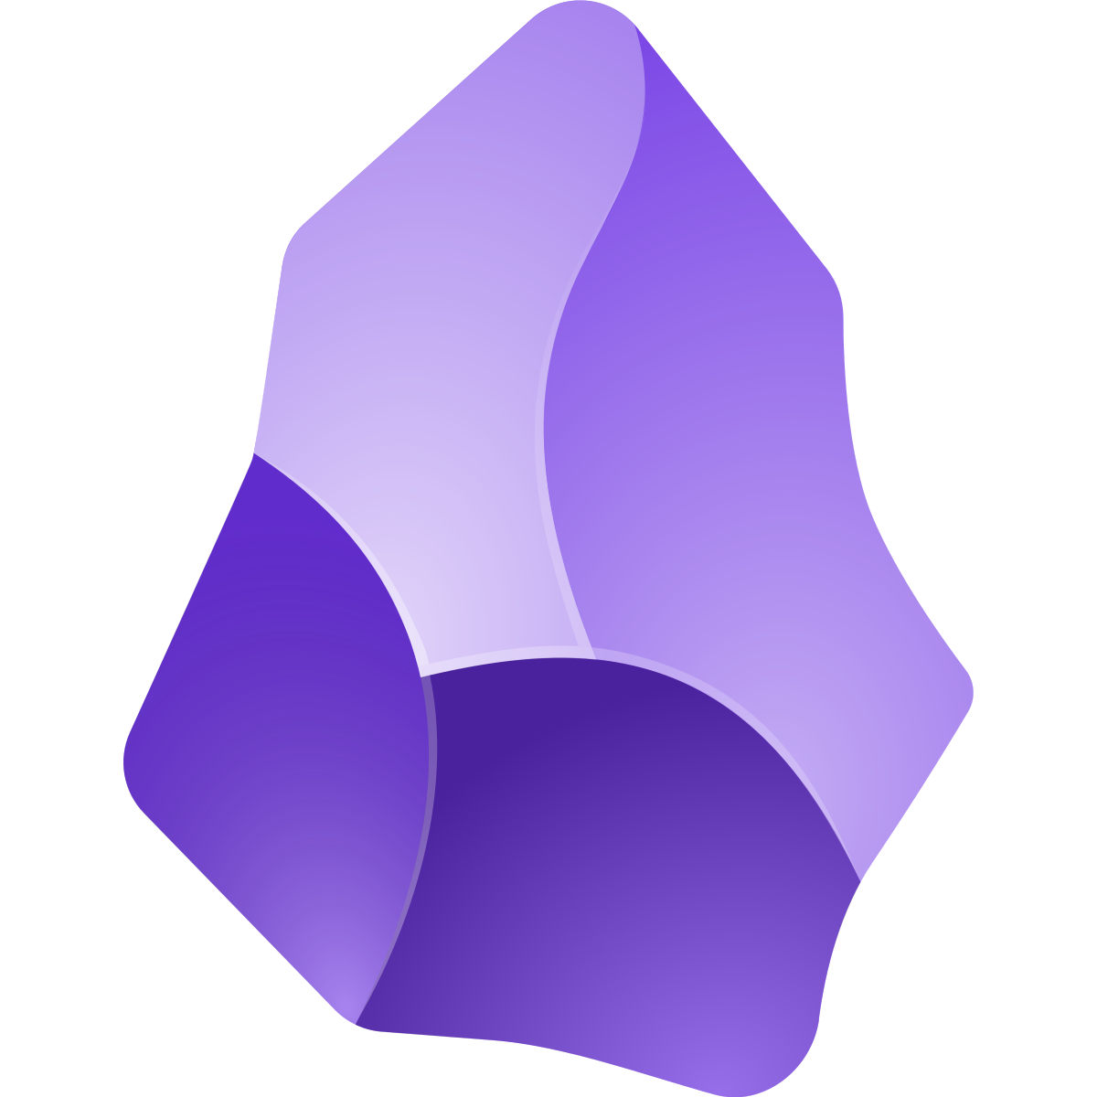
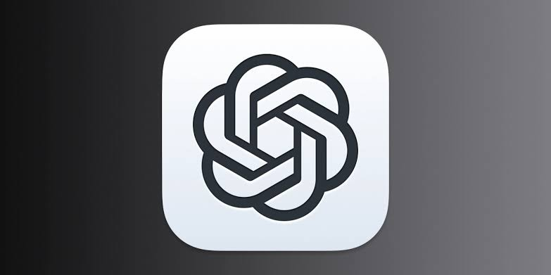

Some cool dev stuff:

Slide 13
Without any further delay, Let's get started 🔥

Slide 14
Installing Flutter:
https://docs.flutter.dev/get-started/install for windows, mac and linux (YOU NEED ANDROID SDK TOOLS)

Slide 15
What is flutter anyways?
Flutter is a Google-made UI toolkit , compiling to native ARM/x86 for max perf.
It bypasses OEM widgets, rendering everything via its own engine for full control.
Cross-platform, one codebase: Android, iOS, web, desktop, Linux.
Uses Skia for rendering, written in C++.

Slide 16
Native Apps:
For native apps, we gotta code differently for each platform. Eg: kotlin/Java.
They have access to native features like hardware and system APIs.
They also feel super buttery smooth.

Slide 17
Cross platform Apps:
it's like websites running on apps (a webview kinda thing).
It is super laggy + inconsistent.
Eg: Cordova.

Slide 18
Hyrbid Apps:
Apps made using Flutter or React Native come under this category, with one codebase.
Flutter uses skia to render own widgets whereas react native connects to native stuff using a js bridge somehow.

Slide 19
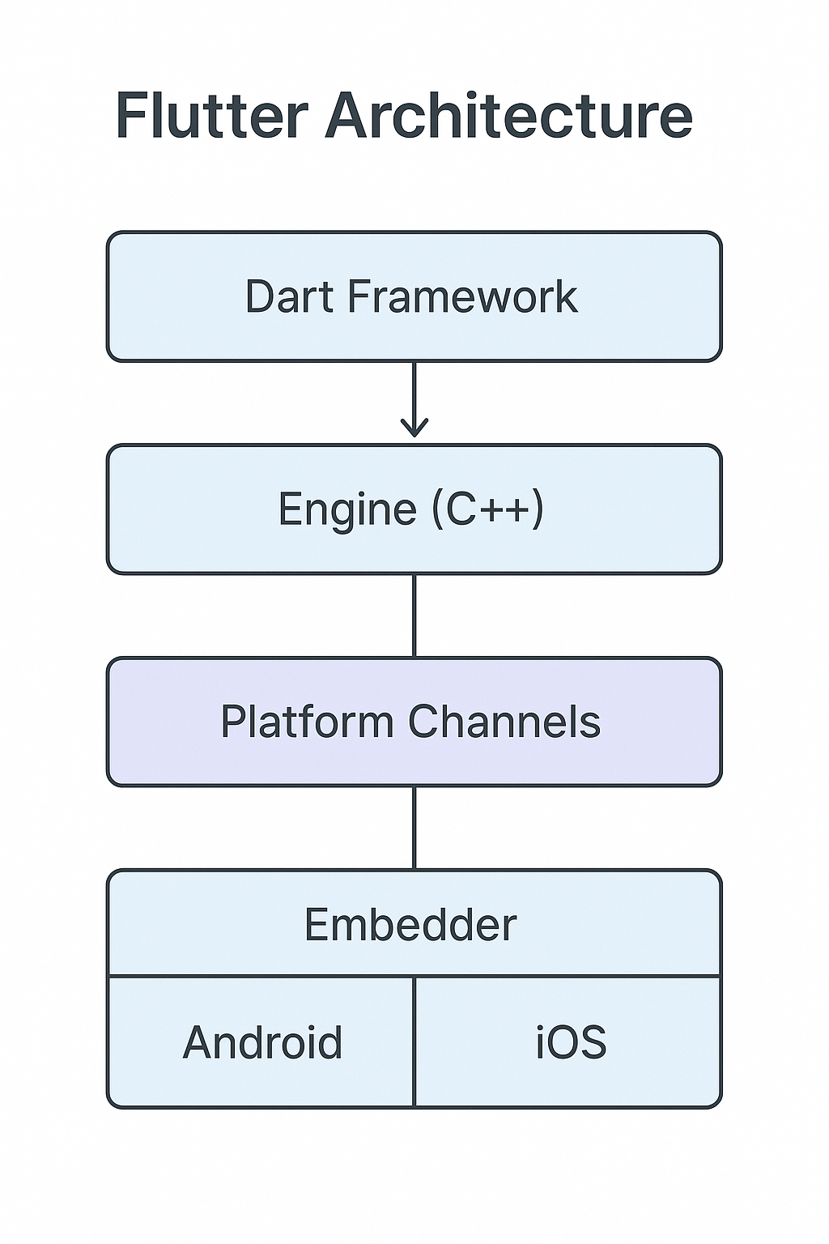

Slide 20
"The risk of curiosity is better than the safety of boredom” - idk

Slide 21
LET'S GET STARTED 🔥
we will use zapp.run

Slide 22
STEP 1:
Let’s install some packages, in pubspec.yaml file
image: ^3.2.2
image_picker: ^0.8.7+4
path_provider: ^2.0.11
flutter_colorpicker: ^1.0.3

Slide 23
STEP 2:
Let’s add the boilerplate code
(stful snippet)

Slide 24
STEP 3:
Let’s create the UI
https://gist.github.com/0Armaan025/c7642a5a807221f023226553690c048d

Slide 25
STEP 4:
Let’s now import important stuff
import 'dart:io';
import 'dart:typed_data';
import 'dart:ui' as ui;
import 'package:flutter/material.dart';
import 'package:image/image.dart' as img;
import 'package:path_provider/path_provider.dart';
import 'package:flutter_colorpicker/flutter_colorpicker.dart';
import 'package:image_picker/image_picker.dart';

Slide 26
STEP 5:
Let’s add some important variables that we will use:
Uint8List? imageBytes;
img.Image? originalImage;

Slide 27
STEP 6:
Let’s create our first function to pick an image:
Future<void> pickImage() async {
final picker = ImagePicker(); // create an instance
final XFile? picked = await picker.pickImage(source: ImageSource.gallery); // get the image in XFile format
if (picked != null) {
final bytes = await picked.readAsBytes(); // convert to bytes
final decoded = img.decodeImage(bytes); // get decoded img
setState(() { // re render screen to show the image
imageBytes = bytes;
originalImage = decoded;
});
}
}

Slide 28
STEP 7:
Let’s create a function to apply grayscale to the image:
void applyGrayscale() {
if (originalImage != null) {
final gray = img.grayscale(originalImage!);
setState(() {
originalImage = gray;
imageBytes = Uint8List.fromList(img.encodeJpg(gray));
});
}
}

Slide 29
STEP 8:
Let’s create a function to apply rotate to the image:
void rotate90() {
if (originalImage != null) {
final rotated = img.copyRotate(originalImage!, 90);
setState(() {
originalImage = rotated;
imageBytes = Uint8List.fromList(img.encodeJpg(rotated));
});
}
}

Slide 30
STEP 8:
Let’s create a function to apply add text to the image:
Future<void> addText(String text) async {
if (originalImage == null) return;
final temp = img.copyResize(originalImage!, width: originalImage!.width);
img.drawString(temp, img.arial_24, 20, 20, text);
setState(() {
originalImage = temp;
imageBytes = Uint8List.fromList(img.encodeJpg(temp));
});
}

Slide 31
Yay! 🥳 🙌, we got something ready!

Slide 32
Q/A / Poll
<poll_link>

Slide 33
THANK YOU EVERYONE! :D
especially to Prashant sir for inviting me ✨
and all the best with your life, make sure to enjoy too!, never compare and keep going!

